Slide 1
TDI: Julia
Operators in Julia
William Mui

Slide 2
Arithmetic Operators

Slide 3
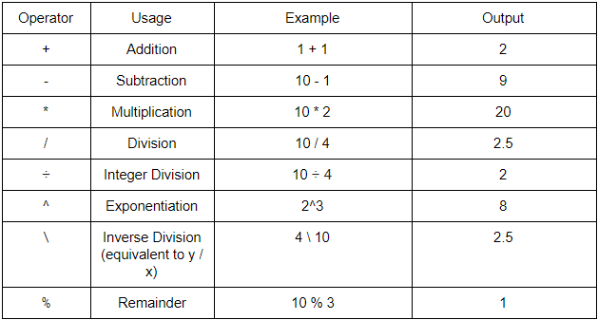
Arithmetic Operators
Support numeric primitive types
The following are the operators in Julia:

Slide 4

Multiplication
If a number placed directly before an identifier or parentheses,
e.g. 2x or 2(x+y) -> treated as a multiplication

Slide 5

Integer divide
Round down to the nearest integer
Could be replaced by round() function
Example:

Slide 6
Bitwise Operators

Slide 7
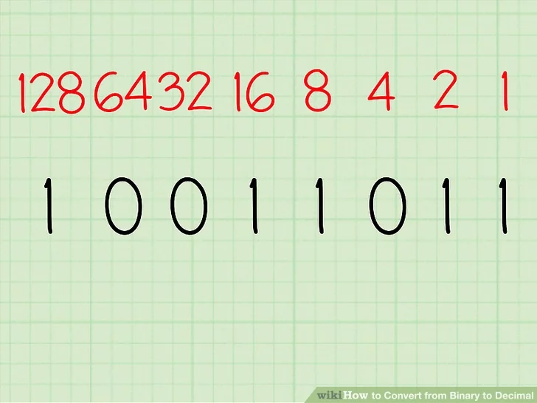
Binary in Computer
In computer, data stored in binary
There is only two state: 0 or 1
"Bit" refers to a single binary digit
1 byte = 8 bits

Slide 8
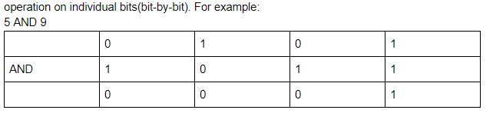
Bitwise Operators
Support all primitive integer types
Operating in bitwise level(bit by bit)
According to logic truth table

Slide 9
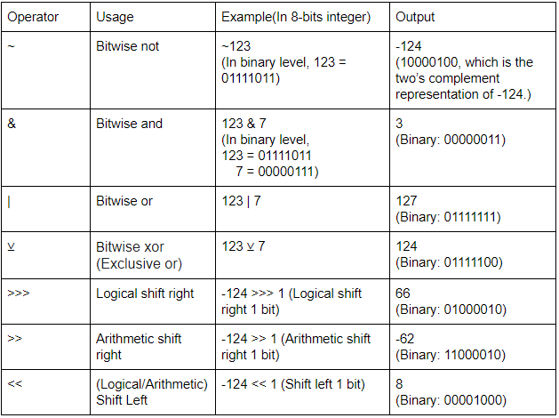
Bitwise Operators

Slide 10
Truth table

Slide 11
Truth table
Mathematical table used in logic
Mention the relationship of input and output

Slide 12
NOT operation
Input | Output
0 | 1
1 | 0
E.g: NOT(00000000b) -> (11111111b)

Slide 13
AND Operation
Input 1 | Input 2 | Output
0 | 0 | 0
0 | 1 | 0
1 | 0 | 0
1 | 1 | 1
E.g. (00001111b) AND (00111100b) = (00001100b)

Slide 14
OR operation
Input 1 | Input 2 | Output
0 | 0 | 0
0 | 1 | 1
1 | 0 | 1
1 | 1 | 1
E.g. (00001111b) OR (00111100b) = (00111111b)

Slide 15
XOR operation
Input 1 | Input 2 | Output
0 | 0 | 0
0 | 1 | 1
1 | 0 | 1
1 | 1 | 0
E.g. (00001111b) OR (00111100b) = (00110011b)

Slide 16
Bitwise Operators - Shift

Slide 17
Why we need shifting?
multiplication and division are costly
Efficient ways to perform multiplication or division
In power of 2

Slide 18
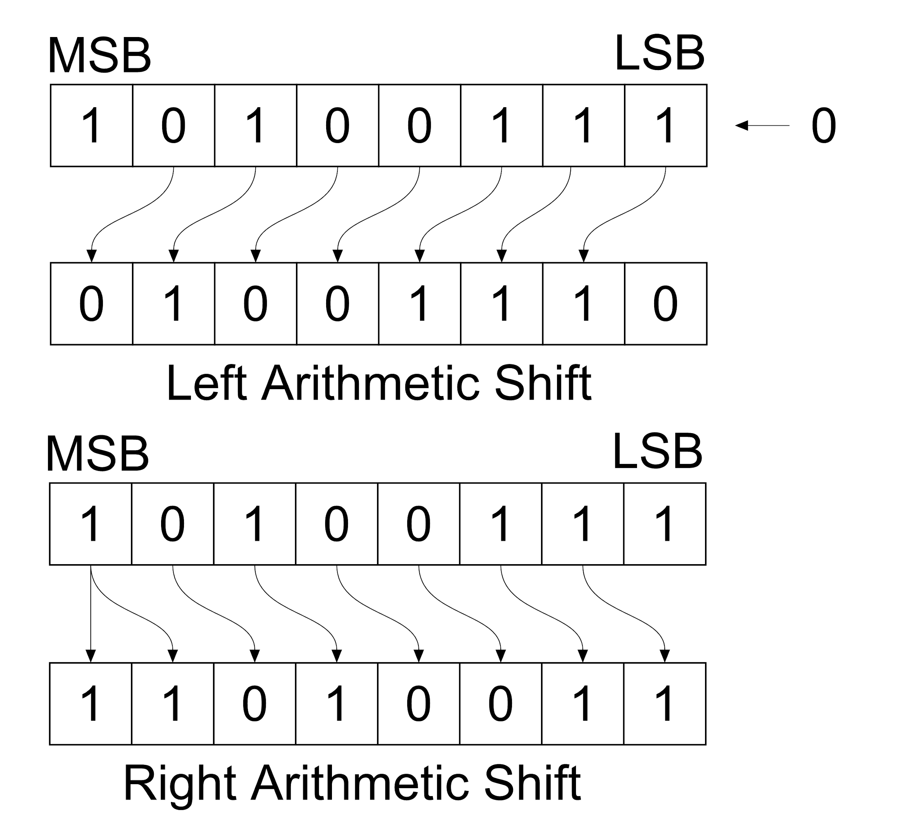
Arithmetic shift
Photo source: https://www.ahirlabs.com/difference/arithmetic-shift-and-logical-shift/

Slide 19
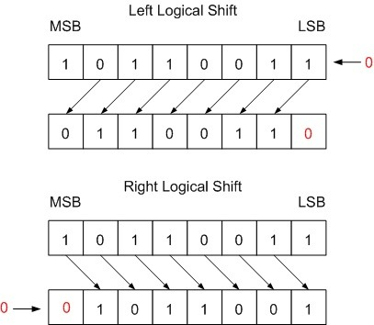
Logical shift
Photo source: https://www.ahirlabs.com/difference/arithmetic-shift-and-logical-shift/

Slide 20
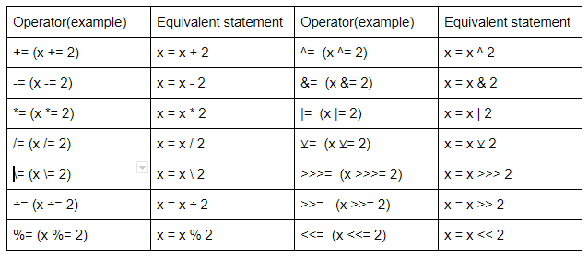
Updating operators
Combine the functions of calculation and assignment on a variable

